Slide 1
IBDP computer science PBL(Project-based learning) + STEAM (Science, Technology, Engineering, Art, Mathematics) Computer Science meets Visual Arts Explore and DIY Image Filter
Di Wu
wudi@rdfz.cn

Slide 2
Activity 1
Take out your camera
Take a picture with different artistic styles
You might use apps on your phone

Slide 3
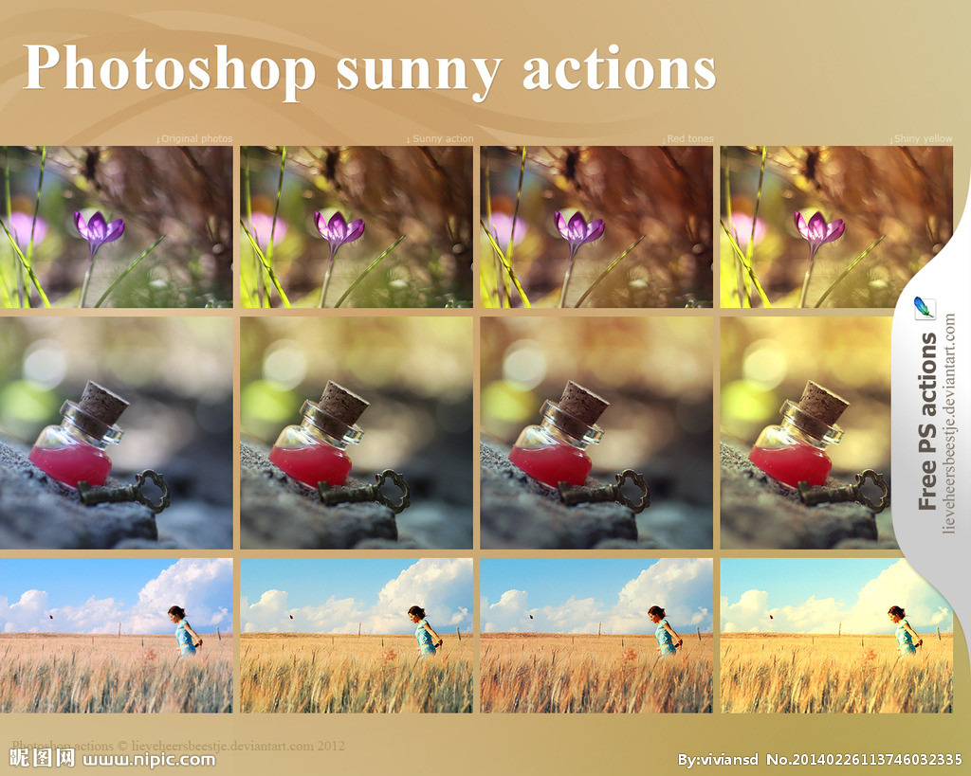

Slide 4
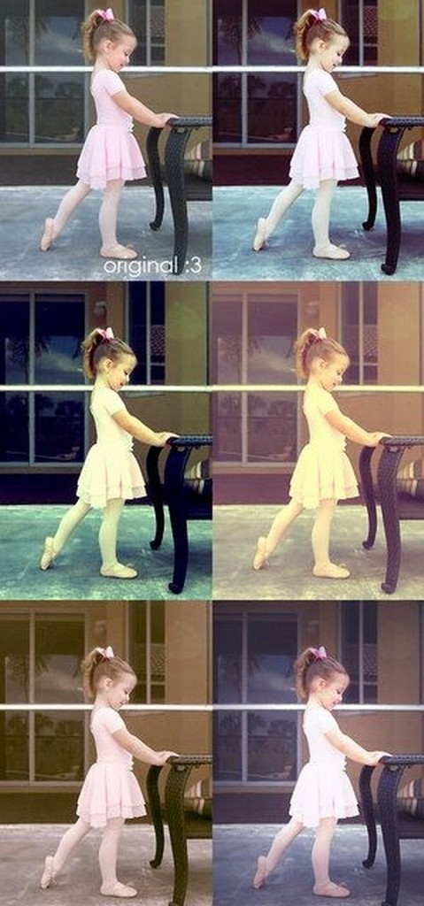
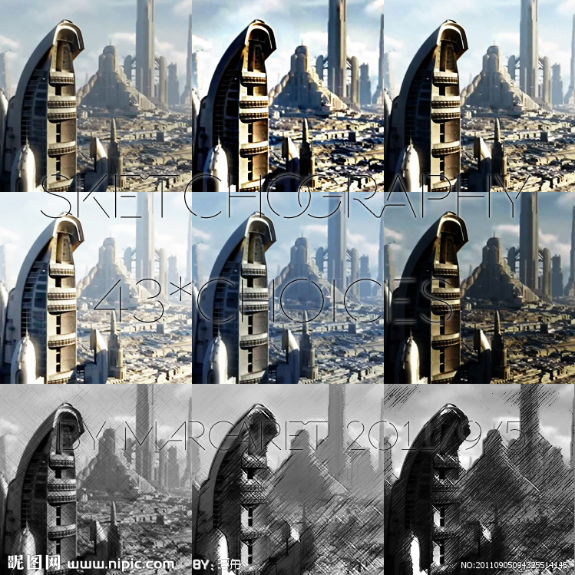

Slide 5
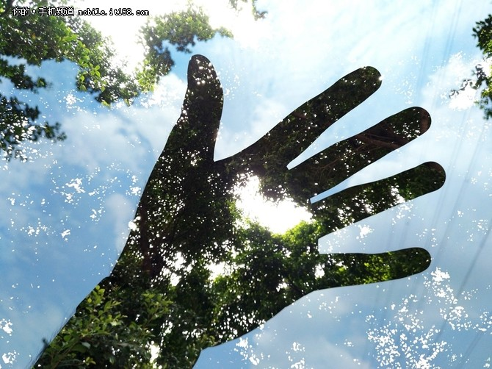

Slide 6
PBL STEAM: Explore and DIY Image Filter Outline
Clear Goals
Assessment rubrics
Cooperative learning of basics
Group learning
Cooperative learning
Team presentation
Self and peer assessment

Slide 7
PBL STEAM: Explore and DIY Image Filter Cooperative learning of basics
A. Color representation: Hexadecimal
B. Colors in images: Binary, gray and color-map
C. Color space: RGB ←→ HSV
D. Image arithmetic and Logic Operation
E. Advanced image operations in OPENCV
Cooperative learning
Students: Teachers
Re-group into 2 big teams of 5 students, each from different topic
Each student in each group take turns to be the teacher
The whole team brain storms about DIY filters
30 minutes

Slide 8
PBL STEAM: Explore and DIY Image Filter Clear goals
STEAM
Science
Computer science
Computational thinking
Technology
Computer tech
Web tech
Engineering
Product design
Product development
Art
Math
Algorithms
Problem solving
programming
Wikispace: cooperative teaching and learning
Color space
Image color adjustment
Image manipulation
Image blending
Digital art
Matrix concept
Logical operation
Space conversion
Matrix computation
GUI graphical user interface

Slide 9
PBL STEAM: Explore and DIY Image Filter Clear goals
Syllabus Content and learning objectives:
Solve real world problem by understanding, applying, analyzing and creating/transferring
System design and analysis (Topic 1)
Human interaction with the system (Topic 1)
Binary representation (Topic 2)
Simple logic gates (Topic 2)
Computational thinking, problem-solving and programming (Topic 4) Higher order ability

Slide 10
PBL STEAM: Explore and DIY Image Filter Clear goals
Processive learning objectives: You should be able to:
Research about the real-world problem, identify the problem, investigate original solutions
Design and develop the software system
Engaged in the team development, communication and cooperation
Fully get and meet your client and user’s requirements
Self-evaluate and peer-review of the software development cycle
Meta cognition: Higher-order thinking skills

Slide 11
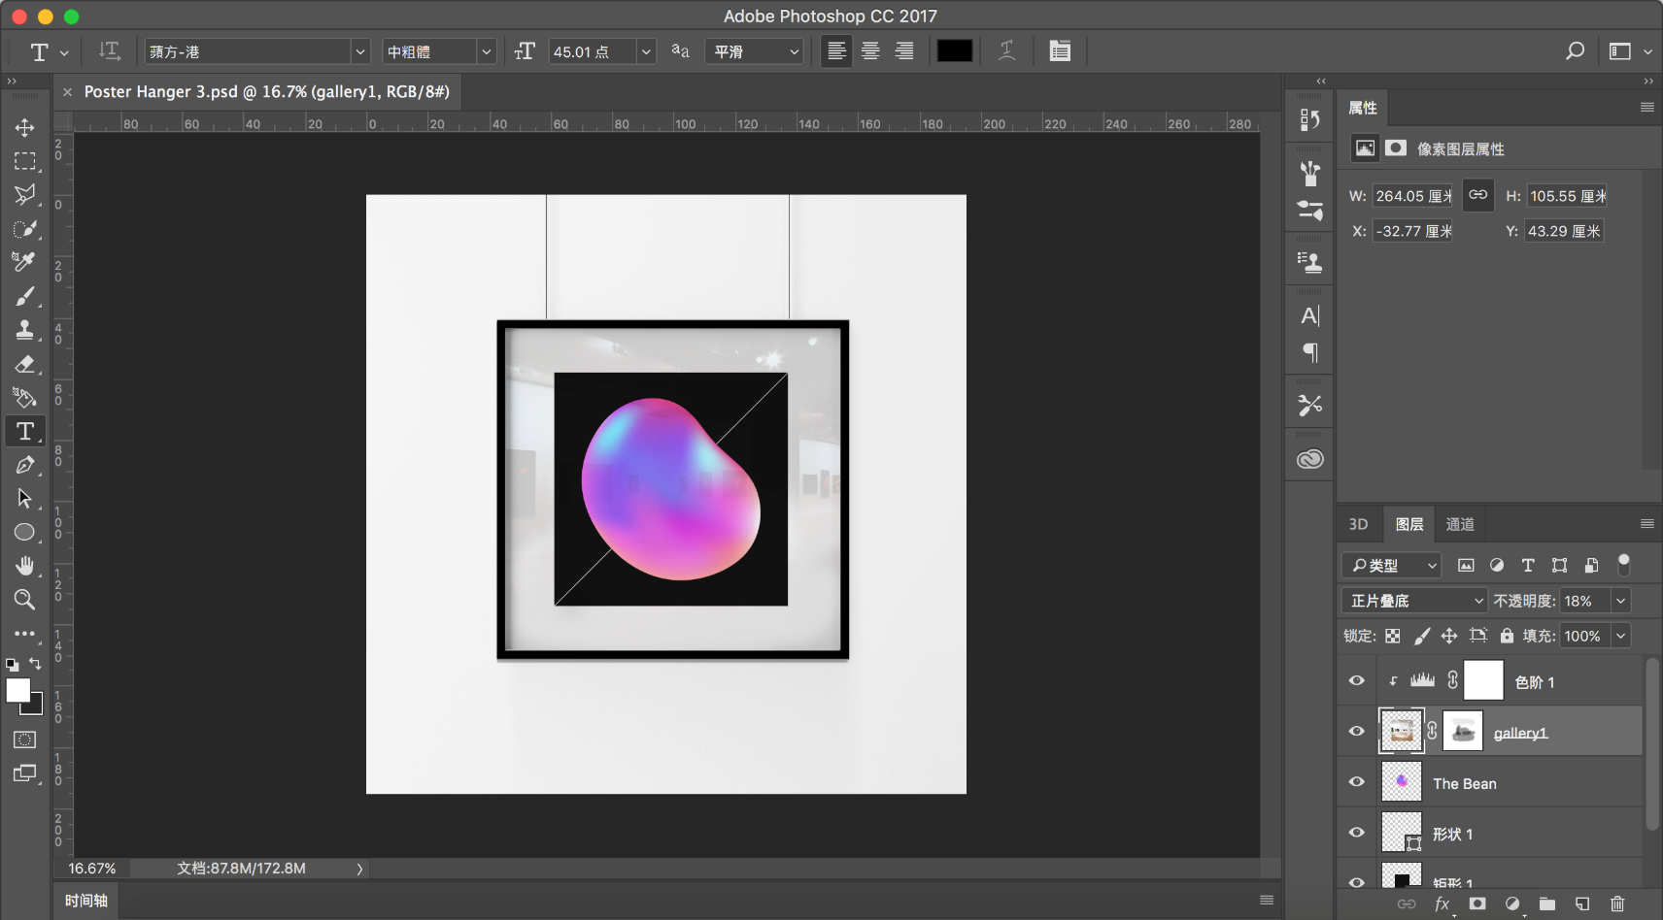
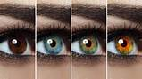
PBL STEAM: Explore and DIY Image Filter Clear goals
Project: Computer Science meets Visual Arts: Explore and DIY Image Filter
The story behind the project.
Notes:
Jasper, an IBDP art student, is studying digital art in Photoshop. He is very interested in manipulating the colors of an image by adjusting the color curve and make special effect of an image using filters. However, he is more curious about how the magic tool works and is there any possibility to have a DIY image filter to help his study in IBDP art.
Further more, all other art students are eager to learn and explore the science behind image filter which could inspire their creation in many different ways.

Slide 12
PBL STEAM: Explore and DIY Image Filter Clear goals
Client: Mrs. Wu
User: Jasper and other Art students
Your Task: Uncover the mystery and DIY image filters
Explore typical Image filters by understanding the science behind
DIY Image filter:
Design and develop an image filter which meets the requirement of Jasper’s (but not limited to) of: color/hue adjustment, Stylized image filter, Image composition.
Provide user-friendly GUI for art students
Development Requirement: Use OOP design in the software system
Teamwork in all aspects of the whole project
Present your product and summary report ( reflection and future plan)
Creation, interdisciplinary and imagination are encouraged!

Slide 13
PBL STEAM: Explore and DIY Image Filter Clear goals
Computer Science meets Visual Arts: Explore and DIY Image Filter
Mar 08 – Basics + exploration + DIY Design
Mar 10 – DIY Design and development
Mar 13 – DIY Design and development
Mar 15 – DIY Design and development
Mar 17 – Presentation (Oral presentation + software demo + report)
Group work: 2-3 students as one group
Creation, interdisciplinary and imagination are encouraged!

Slide 14
PBL STEAM: Explore and DIY Image Filter Outline
Clear Goals
Assessment rubrics
Cooperative learning of basics
Group learning
Cooperative learning
Team presentation
Self and peer assessment

Slide 15
PBL STEAM: Explore and DIY Image Filter Assessment rubrics
Rules in PBL:
1. Everyone in the group takes lead in turn
2. Take research logs continuously
3. Class rules: Teacher clamps hands → push everything you are going into the stack
Activity:2 Practice our agreed rules

Slide 16
PBL STEAM: Explore and DIY Image Filter Assessment rubrics
 | 0 | 1-2 | 3-4 | 5-6
Project Planning and research
The record of tasks and design overview
Project development (identify techniques used in developing the product)
Functionality (evidenced in the video) and extensibility of product
Evaluation: Feedback from the client/adviser and recommend proposals for the future improvement
Communication and collaboration
Activity 3: Get your assessment rubrics in mind

Slide 17
PBL STEAM: Explore and DIY Image Filter Outline
Clear Goals
Assessment rubrics
Cooperative learning of basics
Group learning
Cooperative learning
Team presentation
Self and peer assessment

Slide 18
PBL STEAM: Explore and DIY Image Filter Cooperative learning of basics
A. Color representation: Hexadecimal
B. Colors in images: Binary, gray and color-map
C. Color space: RGB ←→ HSV
D. Image arithmetic and Logic Operation
E. Advanced image operations in OPENCV
System design and analysis (Topic 1)
Human interaction with the system (Topic 1)
Binary representation (Topic 2)
Simple logic gates (Topic 2)
Computational thinking, problem-solving and programming (Topic 4)
Introduction
Group learning
Cooperative learning
Teacher
Students: Researchers
Students: Teachers

Slide 19
PBL STEAM: Explore and DIY Image Filter Cooperative learning of basics
A. Color representation: Hexadecimal
1 color channel: 8 bits, range( 0-255 )
R G B
3 color channel: 24 bits, range( 0-255^3 )
(255，0，0）
Color Red
Binary: 11111111, 00000000, 00000000
Denary: 255, 0, 0
Hexadecimal: FF0000
(0，255，0）
(0，0，255）
Simulation
Notes:
http://www.cnblogs.com/jackStudy/archive/2012/06/26/2563261.html
http://www.cnblogs.com/grenet/archive/2009/12/13/1622930.html
1 java simulation
ifanview

Slide 20
PBL STEAM: Explore and DIY Image Filter Cooperative learning of basics
A. Color representation: Hexadecimal
Binary v.s. Denary v.s. Hexadecimal
Advantage of hexadecimal
Obtain the pixel color from an image interactively
Use hexadecimal color representation in GUI design
Try different digits combinations in color space
Notes:
http://www.cnblogs.com/jackStudy/archive/2012/06/26/2563261.html
http://www.cnblogs.com/grenet/archive/2009/12/13/1622930.html

Slide 21
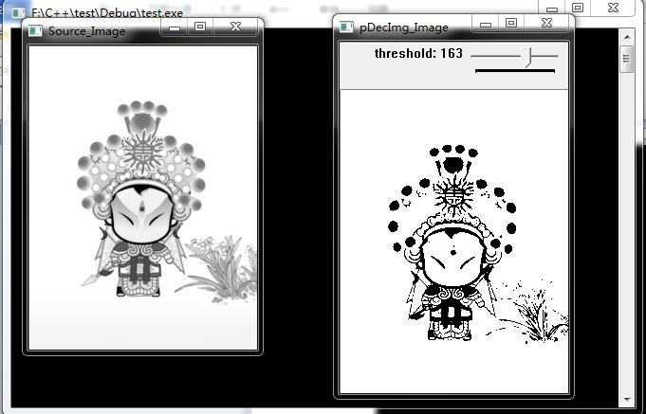
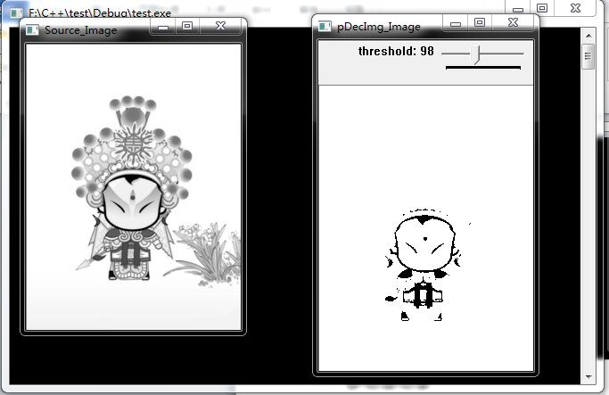
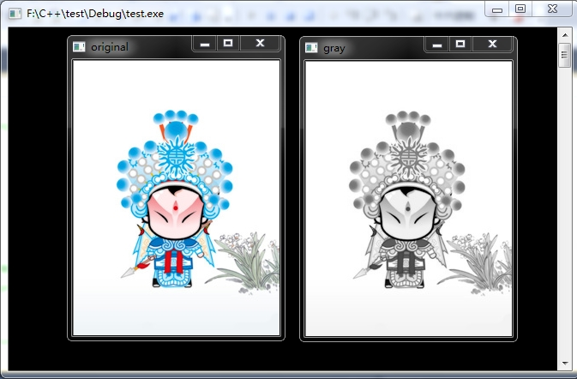
B. Colors in images: Binary, gray and color-map
binary= 0 if grayValue < Threshold
binary= 1 if grayValue >= Threshold
gray = 0.2989 * r + 0.5870 * g + 0.1140 * b
Color image
Gray image
Binary image
(10, 20, 200)
(189)
http://docs.opencv.org/trunk/d7/d4d/tutorial_py_thresholding.html

Slide 22
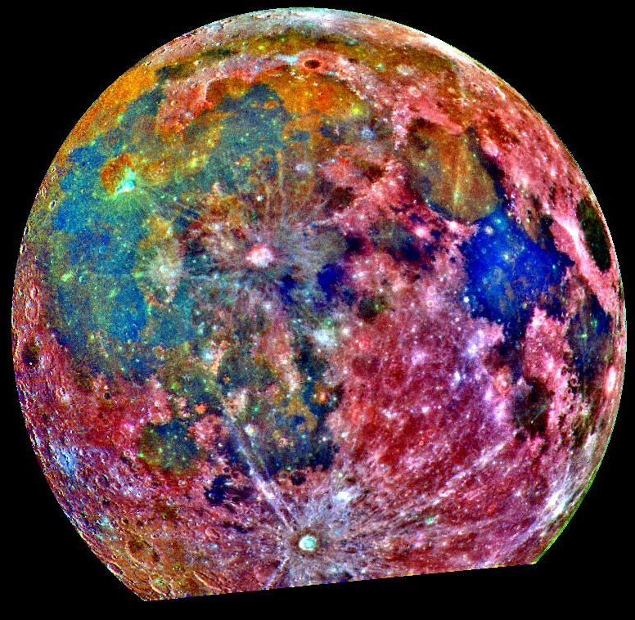
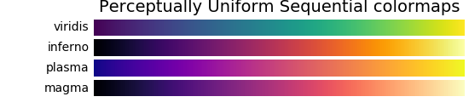
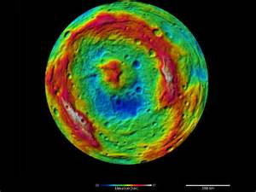
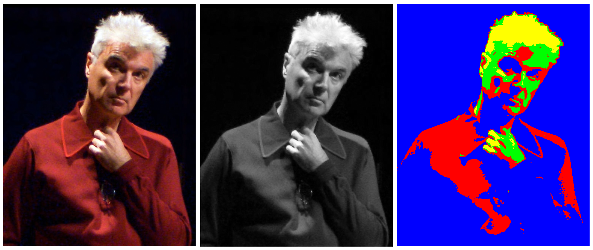
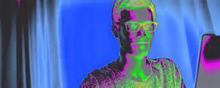
B. Colors in images: Binary, gray and color-map

Slide 23
PBL STEAM: Explore and DIY Image Filter Cooperative learning of basics
B. Colors in images: Binary, gray and color-map
Binary (0 or 1) image, Gray (0~255) image, RGB (0~255,0~255,0~255) color image
False color image: Not real color, use color for better visualization
GUI app to convert RGB image → gray image → binary image ( with an input from user, maybe a textbox/slider to control the threshold)
GUI app to allow user to choose different colormap to show false color of a gray image
Notes:
http://www.cnblogs.com/jackStudy/archive/2012/06/26/2563261.html
http://www.cnblogs.com/grenet/archive/2009/12/13/1622930.html

Slide 24

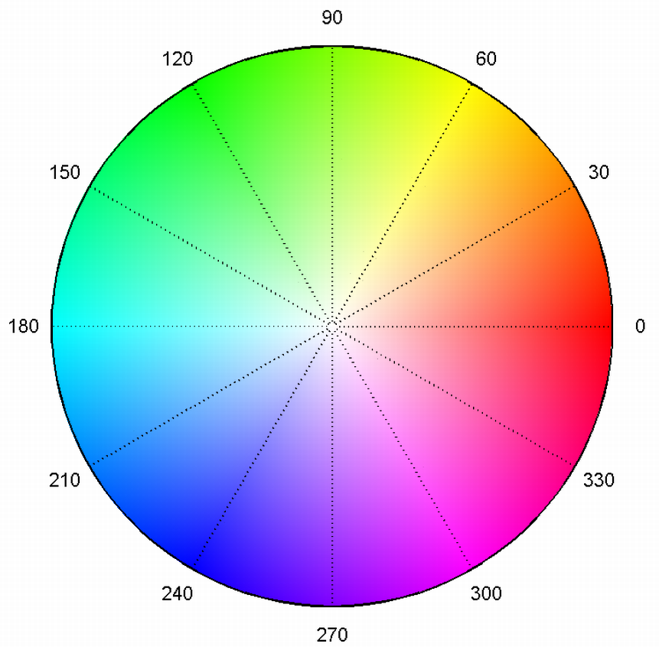
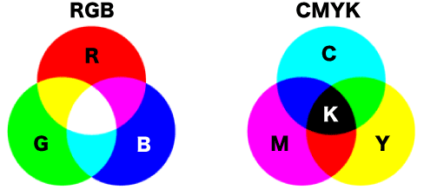
PBL STEAM: Explore and DIY Image Filter Cooperative learning of basics
C. Color space: RGB --- HSV
Human perception
Color / intensity
Monitor
Printer
ADVANTAGE OF HSV COLOR SPACE
Unlike RGB and CMYK, which are defined in relation to primary colors, HSV is defined in a way that is similar to how humans perceive color.
Notes:
http://www.rapidtables.com/convert/color/hsv-to-rgb.htm
The HSV color space is used by people when they select colors for paint or ink because HSV better represents how people relate to colors than does the RGB color space. The HSV color wheel is also used to generate high-quality graphics. Although less well known that its RGB and CMYK cousins, it is available in many high-end image editing software programs.
Selecting an HSV color begins with picking one of the available hues, which is how most humans relate to color, and then adjusting the shade and brightness value.
ADVANTAGE OF HSV COLOR SPACE
Unlike RGB and CMYK, which are defined in relation to primary colors, HSV is defined in a way that is similar to how humans perceive color.
Note, however, that HSV is one of many color spaces that separate color from intensity (See YCbCr, Lab, etc.). HSV is often used simply because the code for converting between RGB and HSV is widely available and can also be easily implemented.

Slide 25
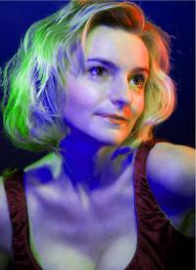
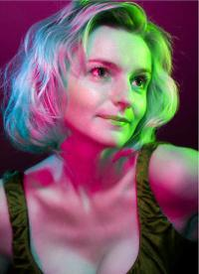
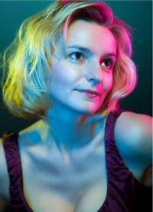
PBL STEAM: Explore and DIY Image Filter Cooperative learning of basics
C. Color space: RGB --- HSV
Original
hue+50
hue+133
Notes:
http://www.rapidtables.com/convert/color/hsv-to-rgb.htm
The HSV color space is used by people when they select colors for paint or ink because HSV better represents how people relate to colors than does the RGB color space. The HSV color wheel is also used to generate high-quality graphics. Although less well known that its RGB and CMYK cousins, it is available in many high-end image editing software programs.
Selecting an HSV color begins with picking one of the available hues, which is how most humans relate to color, and then adjusting the shade and brightness value.
ADVANTAGE OF HSV COLOR SPACE
Unlike RGB and CMYK, which are defined in relation to primary colors, HSV is defined in a way that is similar to how humans perceive color.
Note, however, that HSV is one of many color spaces that separate color from intensity (See YCbCr, Lab, etc.). HSV is often used simply because the code for converting between RGB and HSV is widely available and can also be easily implemented.

Slide 26
PBL STEAM: Explore and DIY Image Filter Cooperative learning of basics
C. Color space: RGB --- HSV
RGB v.s. CMKY v.s. HSV? Applications and advantages of each
Convert algorithm: RGB ←→ HSV
Color space conversion in your project
Adjustment of hue (color wheel)
Change of saturation and intensity
Analyze and comment of the art design of Spring Festival Gala
Notes:
http://www.rapidtables.com/convert/color/hsv-to-rgb.htm
The HSV color space is used by people when they select colors for paint or ink because HSV better represents how people relate to colors than does the RGB color space. The HSV color wheel is also used to generate high-quality graphics. Although less well known that its RGB and CMYK cousins, it is available in many high-end image editing software programs.
Selecting an HSV color begins with picking one of the available hues, which is how most humans relate to color, and then adjusting the shade and brightness value.
ADVANTAGE OF HSV COLOR SPACE
Unlike RGB and CMYK, which are defined in relation to primary colors, HSV is defined in a way that is similar to how humans perceive color.
Note, however, that HSV is one of many color spaces that separate color from intensity (See YCbCr, Lab, etc.). HSV is often used simply because the code for converting between RGB and HSV is widely available and can also be easily implemented.

Slide 27
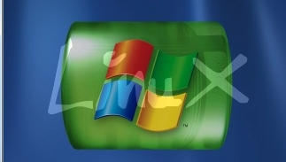
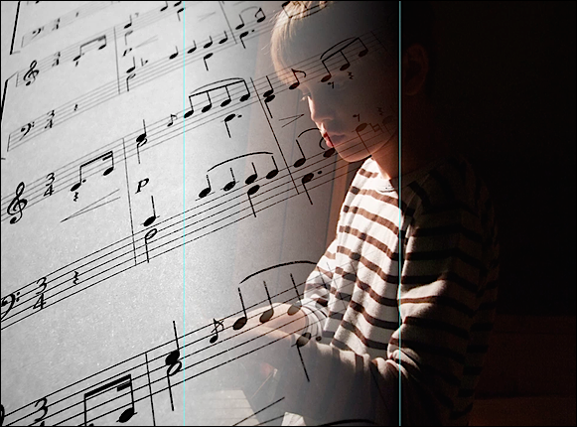
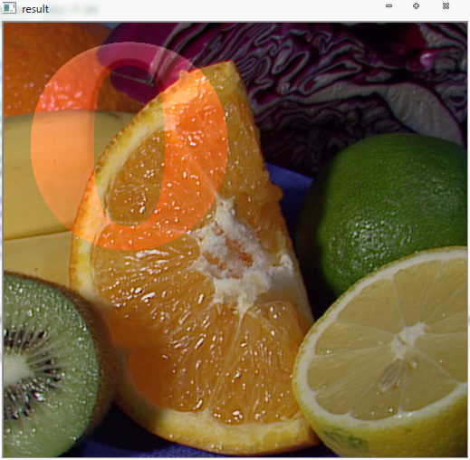
PBL STEAM: Explore and DIY Image Filter Cooperative learning of basics
D. Image arithmetic and Logic Operation
Notes:
http://www.rapidtables.com/convert/color/hsv-to-rgb.htm
The HSV color space is used by people when they select colors for paint or ink because HSV better represents how people relate to colors than does the RGB color space. The HSV color wheel is also used to generate high-quality graphics. Although less well known that its RGB and CMYK cousins, it is available in many high-end image editing software programs.
Selecting an HSV color begins with picking one of the available hues, which is how most humans relate to color, and then adjusting the shade and brightness value.
ADVANTAGE OF HSV COLOR SPACE
Unlike RGB and CMYK, which are defined in relation to primary colors, HSV is defined in a way that is similar to how humans perceive color.
Note, however, that HSV is one of many color spaces that separate color from intensity (See YCbCr, Lab, etc.). HSV is often used simply because the code for converting between RGB and HSV is widely available and can also be easily implemented.

Slide 28
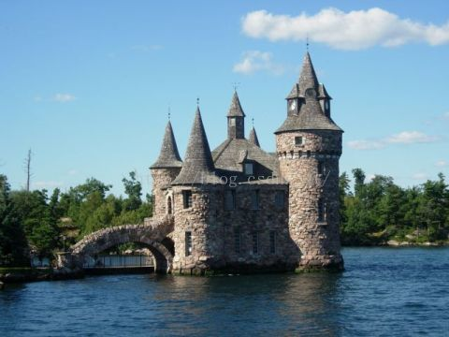

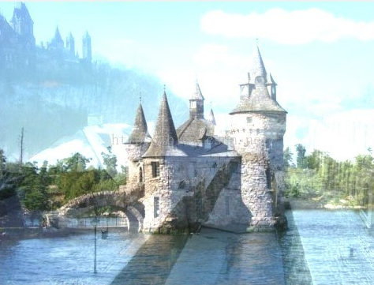
PBL STEAM: Explore and DIY Image Filter Cooperative learning of basics
D. Image arithmetic and Logic Operation
Notes:
http://www.rapidtables.com/convert/color/hsv-to-rgb.htm
The HSV color space is used by people when they select colors for paint or ink because HSV better represents how people relate to colors than does the RGB color space. The HSV color wheel is also used to generate high-quality graphics. Although less well known that its RGB and CMYK cousins, it is available in many high-end image editing software programs.
Selecting an HSV color begins with picking one of the available hues, which is how most humans relate to color, and then adjusting the shade and brightness value.
ADVANTAGE OF HSV COLOR SPACE
Unlike RGB and CMYK, which are defined in relation to primary colors, HSV is defined in a way that is similar to how humans perceive color.
Note, however, that HSV is one of many color spaces that separate color from intensity (See YCbCr, Lab, etc.). HSV is often used simply because the code for converting between RGB and HSV is widely available and can also be easily implemented.

Slide 29
PBL STEAM: Explore and DIY Image Filter Cooperative learning of basics
D. Image arithmetic and Logic Operation
Color image → 3 channels of R-G-B components (each a 2D matrix)
Manipulate 3D matrix for color image using numpy module
Image arithmetic operations: matrix +, -, *, /
Image Logic(binary image) operations : AND, OR, NOR, XOR
Image linear blending, GUI to control the blending ratio
Image calculations:Ox04
http://docs.opencv.org/trunk/df/d9d/tutorial_py_colorspaces.html
Basic operations on images
http://docs.opencv.org/trunk/d3/df2/tutorial_py_basic_ops.html
Image arithmetic and Logic Opera
http://docs.opencv.org/trunk/d0/d86/tutorial_py_image_arithmetics.html
http://blog.csdn.net/you_are_my_dream/article/details/52925750
Notes:
http://www.rapidtables.com/convert/color/hsv-to-rgb.htm
The HSV color space is used by people when they select colors for paint or ink because HSV better represents how people relate to colors than does the RGB color space. The HSV color wheel is also used to generate high-quality graphics. Although less well known that its RGB and CMYK cousins, it is available in many high-end image editing software programs.
Selecting an HSV color begins with picking one of the available hues, which is how most humans relate to color, and then adjusting the shade and brightness value.
ADVANTAGE OF HSV COLOR SPACE
Unlike RGB and CMYK, which are defined in relation to primary colors, HSV is defined in a way that is similar to how humans perceive color.
Note, however, that HSV is one of many color spaces that separate color from intensity (See YCbCr, Lab, etc.). HSV is often used simply because the code for converting between RGB and HSV is widely available and can also be easily implemented.

Slide 30
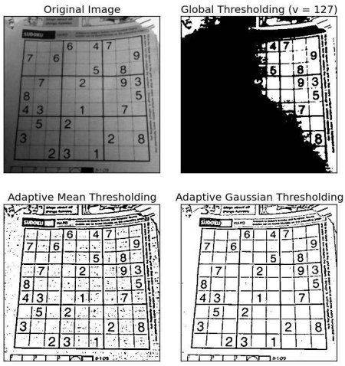
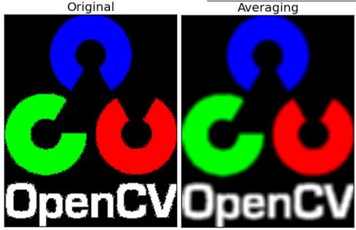
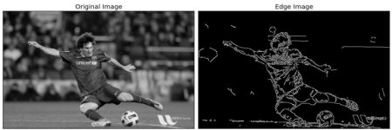
PBL STEAM: Explore and DIY Image Filter Cooperative learning of basics
E. Advanced image operations in OPENCV
Notes:
http://www.rapidtables.com/convert/color/hsv-to-rgb.htm
The HSV color space is used by people when they select colors for paint or ink because HSV better represents how people relate to colors than does the RGB color space. The HSV color wheel is also used to generate high-quality graphics. Although less well known that its RGB and CMYK cousins, it is available in many high-end image editing software programs.
Selecting an HSV color begins with picking one of the available hues, which is how most humans relate to color, and then adjusting the shade and brightness value.
ADVANTAGE OF HSV COLOR SPACE
Unlike RGB and CMYK, which are defined in relation to primary colors, HSV is defined in a way that is similar to how humans perceive color.
Note, however, that HSV is one of many color spaces that separate color from intensity (See YCbCr, Lab, etc.). HSV is often used simply because the code for converting between RGB and HSV is widely available and can also be easily implemented.

Slide 31
PBL STEAM: Explore and DIY Image Filter Cooperative learning of basics
E. Advanced image operations in OPENCV
Changing color space:
http://docs.opencv.org/trunk/df/d9d/tutorial_py_colorspaces.html
Image Gradient:
http://docs.opencv.org/trunk/d5/d0f/tutorial_py_gradients.html
Image threshold
http://docs.opencv.org/trunk/d7/d4d/tutorial_py_thresholding.html
Image histograms
http://docs.opencv.org/trunk/de/db2/tutorial_py_table_of_contents_histograms.html
Smooth images
http://docs.opencv.org/trunk/d4/d13/tutorial_py_filtering.html
Image calculations: first 3 sections
http://docs.opencv.org/trunk/df/d9d/tutorial_py_colorspaces.html
Canny Edge Detection
http://docs.opencv.org/trunk/da/d22/tutorial_py_canny.html
Image Pyramid
http://docs.opencv.org/trunk/dc/dff/tutorial_py_pyramids.html
Notes:
http://www.rapidtables.com/convert/color/hsv-to-rgb.htm
The HSV color space is used by people when they select colors for paint or ink because HSV better represents how people relate to colors than does the RGB color space. The HSV color wheel is also used to generate high-quality graphics. Although less well known that its RGB and CMYK cousins, it is available in many high-end image editing software programs.
Selecting an HSV color begins with picking one of the available hues, which is how most humans relate to color, and then adjusting the shade and brightness value.
ADVANTAGE OF HSV COLOR SPACE
Unlike RGB and CMYK, which are defined in relation to primary colors, HSV is defined in a way that is similar to how humans perceive color.
Note, however, that HSV is one of many color spaces that separate color from intensity (See YCbCr, Lab, etc.). HSV is often used simply because the code for converting between RGB and HSV is widely available and can also be easily implemented.

Slide 32
PBL STEAM: Explore and DIY Image Filter Cooperative learning of basics
A. Color representation: Hexadecimal
B. Colors in images: Binary, gray and color-map
C. Color space: RGB ←→ HSV
D. Image arithmetic and Logic Operation
E. Advanced image operations in OPENCV
Group learning
Students: Researchers
2 students as a group choose one topic
Research through the links on our wiki
Practice the demo code
Answer/try to Implement the points in the green box
20 minutes

Slide 33
PBL STEAM: Explore and DIY Image Filter Cooperative learning of basics
A. Color representation: Hexadecimal
B. Colors in images: Binary, gray and color-map
C. Color space: RGB ←→ HSV
D. Image arithmetic and Logic Operation
E. Advanced image operations in OPENCV
Cooperative learning
Students: Teachers
Re-group into 2 big teams of 5 students, each from different topic
Each student in each group take turns to be the teacher
The whole team brain storms about DIY filters
25 minutes

Slide 34
PBL STEAM: Explore and DIY Image Filter Cooperative learning of basics
A. Color representation: Hexadecimal
B. Colors in images: Binary, gray and color-map
C. Color space: RGB ←→ HSV
D. Image arithmetic and Logic Operation
E. Advanced image operations in OPENCV
Team presentation
Students: Presenter
Each group do an oral presentation of their project design
Everyone do a self-reflection assessment and peer assessment
15 minutes

Slide 35
PBL STEAM: Explore and DIY Image Filter Timeline
Homework:
Teamwork – design DIY image filter
Teamwork – make the timeline
Teamwork – Go over and study the basics in this lesson
Computer Science meets Visual Arts: Explore and DIY Image Filter
Mar 08 – Basics + exploration + DIY Design
Mar 10 – DIY Design and development
Mar 13 – DIY Design and development
Mar 15 – DIY Design and development
Mar 17 – Presentation (Oral presentation + software demo + report)
Group work: 2 students as one group
Creation, interdisciplinary and imagination are encouraged!

